Slide 1
Task 3: Data Cleansing & Feature Engineering
By: Shashi & Erin

Slide 2
Let’s Begin:
Data Cleansing - Data cleansing is the effort to improve the overall quality of data by removing or correcting inaccurate, incomplete, or irrelevant data from a data system.
Data could be cleaned by many ways:-
1)Data Integrity
2)Missing Values
3)Extreme Values, and
4)Extreme Distribution
Data Integrity:-
General data integrity first steps:
• Checking for dupes
• Checking for consistency within variables
• Checking numeric variables
• Checking character variables
• Checking dates

Slide 3
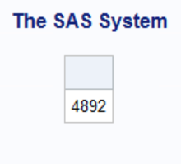
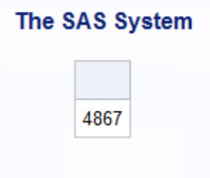
Data Integrity
Checking for Duplicates –
The NODUPKEY option compares only the variables listed in the BY statement when it looks for matches. If the BY statement variables are the same, then any subsequent records after the first one encountered are removed.
In the input dataset, we took EMPLOYEE_NO as a primary key in which duplicates should be excluded to get a clean data.
Number of observations before and after checking the duplicates
Before | After

Slide 4
Data Integrity
Checking for consistency within variables –
Before After
EducationField | Frequency | Percent | Cumulative | Cumulative
 |  |  | Frequency | Percent
Human Resources | 27 | 1.84 | 27 | 1.84
LS | 139 | 9.46 | 166 | 11.29
Life Sciences | 467 | 31.77 | 633 | 43.06
Marketing | 128 | 8.71 | 761 | 51.77
Medical | 464 | 31.56 | 1225 | 83.33
Mkt | 31 | 2.11 | 1256 | 85.44
Other | 82 | 5.58 | 1338 | 91.02
Tech | 30 | 2.04 | 1368 | 93.06
Technical Degree | 102 | 6.94 | 1470 | 100
EducationField_1 | Frequency | Percent | Cumulative | Cumulative
 |  |  | Frequency | Percent
Human Resources | 27 | 1.84 | 27 | 1.84
Life Sciences | 606 | 41.22 | 633 | 43.06
Marketing | 159 | 10.82 | 792 | 53.88
Medical | 464 | 31.56 | 1256 | 85.44
Other | 82 | 5.58 | 1338 | 91.02
Technical | 132 | 8.98 | 1470 | 100
Department | Frequency | Percent | Cumulative | Cumulative
 |  |  | Frequency | Percent
Human Resources | 63 | 4.29 | 63 | 4.29
Research & D | 25 | 1.7 | 88 | 5.99
Research & Development | 936 | 63.67 | 1024 | 69.66
Sales | 446 | 30.34 | 1470 | 100
Department_1 | Frequency | Percent | Cumulative | Cumulative
 |  |  | Frequency | Percent
Human Resources | 63 | 11.8 | 63 | 11.8
Research & D | 25 | 4.68 | 88 | 16.48
Sales | 446 | 83.52 | 534 | 100
Frequency Missing = 936

Slide 5
Data Integrity
Coding error – An incorrect variable value in a data set, which may include missing values
Checking the Numerical variables :-
1)N shows number of non-missing values
2)NMISS shows number of missing values
3) MIN and MAX can suggest values to check out
4)Mean shows mean value of all the numeric variables
5)Median shows the median of all the numeric variables

Slide 6
Numeric Variables:
Variable | Label | N | N Miss | Minimum | Mean | Median | Maximum
DailyRate | DailyRate | 1445 | 25 | 10.2 | 801.67 | 799 | 1499
DistanceFromHome | DistanceFromHome | 1470 | 0 | 1 | 9.19 | 7 | 29
Education | Education | 1470 | 0 | 1 | 2.91 | 3 | 5
EnvironmentSatisfaction | EnvironmentSatisfaction | 1470 | 0 | 1 | 2.72 | 3 | 4
HourlyRate | HourlyRate | 1470 | 0 | 30 | 65.89 | 66 | 100
JobInvolvement | JobInvolvement | 1470 | 0 | 1 | 2.73 | 3 | 4
JobLevel | JobLevel | 1470 | 0 | 1 | 2.06 | 2 | 5
JobSatisfaction | JobSatisfaction | 1470 | 0 | 1 | 2.73 | 3 | 4
MonthlyIncome | MonthlyIncome | 1445 | 25 | 1009 | 6708.64 | 4900 | 199999
NumCompaniesWorked | NumCompaniesWorked | 1470 | 0 | 0 | 2.69 | 2 | 9
PercentSalaryHike | PercentSalaryHike | 1470 | 0 | 11 | 15.21 | 14 | 25
PerformanceRating | PerformanceRating | 1470 | 0 | 3 | 3.15 | 3 | 4
RelationshipSatisfaction | RelationshipSatisfaction | 1470 | 0 | 1 | 2.71 | 3 | 4
StockOptionLevel | StockOptionLevel | 1470 | 0 | 0 | 0.79 | 1 | 3
TotalWorkingYears | TotalWorkingYears | 1470 | 0 | 0 | 11.28 | 10 | 40
TrainingTimesLastYear | TrainingTimesLastYear | 1470 | 0 | 0 | 2.8 | 3 | 6
WorkLifeBalance | WorkLifeBalance | 1470 | 0 | 1 | 2.76 | 3 | 4
YearsInCurrentRole | YearsInCurrentRole | 1470 | 0 | 0 | 4.23 | 3 | 18
YearsSinceLastPromotion | YearsSinceLastPromotion | 1470 | 0 | 0 | 2.19 | 1 | 15
YearsWithCurrManager | YearsWithCurrManager | 1470 | 0 | 0 | 4.12 | 3 | 17
birth_dt |  | 1395 | 75 | -1214 | 7292.19 | 7769 | 14370.5
depart_dt |  | 237 | 1233 | 20091 | 20636.97 | 20599 | 21184
employ_1 |  | 1470 | 0 | 0 | 0.16 | 0 | 1
employee_no |  | 1470 | 0 | 2583 | 510126.17 | 508447.5 | 999834
fico_scr |  | 1470 | 0 | 675 | 730.69 | 729 | 820
hire_dt |  | 1470 | 0 | 5761 | 18208.25 | 18851.38 | 21164
took_survey |  | 1470 | 0 | 1 | 1 | 1 | 1
Notes:
MV’s were found in the variables DailyRate, MonthlyIncome, birth_dt, and depart_dt.

Slide 7
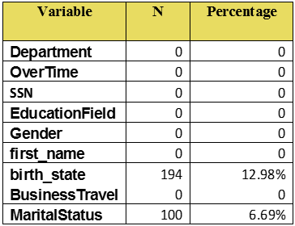
Data Integrity
Checking Character Values –
In checking character values, we found only two variables (birth_state and MaritalStatus) having the missing values.

Slide 8
Data Integrity
Checking Date Values –
Variable | N | Mean | Std Dev | Minimum | Maximum
birth_dt | 1395 | 7292.2 | 3312.13 | -1214 | 14370.5
hire_dt | 1470 | 18208 | 2241.12 | 5761 | 21164
depart_dt | 237 | 20637 | 329.36189 | 20091 | 21184

Slide 9
Missing Values
Missing Values –Missing data, or missing values, occur when no data value is stored for the variable in an observation. Missing data are a common occurrence and can have a significant effect on the conclusions that can be drawn from the data.
Missing Values
Checking missing values in the data
Types of missing values
Solving the issue of missing value
For continuous/numeric variables “PROC MEANS” is used to find missing value by using N & N MISS, and for categorical variables “PROC FREQ”.
MCAR (Missing completely at Ramdom)
Segmentation Imputation
MAR (Missing at Random)
MNAR
(Missing not at Random)
Mean or Median Imputation

Slide 10
Missing Values
Missing value in Dataset
Variable | N | N Miss | % of Missing Values
DailyRate | 1445 | 25 | 0.51
DistanceFromHome | 1470 | 0
Education | 1470 | 0
EnvironmentSatisfaction | 1470 | 0
HourlyRate | 1470 | 0
JobInvolvement | 1470 | 0
JobLevel | 1470 | 0
JobSatisfaction | 1470 | 0
MonthlyIncome | 1445 | 25 | 0.51
NumCompaniesWorked | 1470 | 0
PercentSalaryHike | 1470 | 0
PerformanceRating | 1470 | 0
RelationshipSatisfaction | 1470 | 0
StockOptionLevel | 1470 | 0
TotalWorkingYears | 1470 | 0
TrainingTimesLastYear | 1470 | 0
WorkLifeBalance | 1470 | 0
YearsInCurrentRole | 1470 | 0
YearsSinceLastPromotion | 1470 | 0
YearsWithCurrManager | 1470 | 0
birth_dt | 1395 | 75 | 1.54
depart_dt | 237 | 1233 | 25.33
employ_1 | 1470 | 0
employee_attr | 1470 | 0
employee_no | 1470 | 0
fico_scr | 1470 | 0
hire_dt | 1470 | 0
took_survey | 1470 | 0

Slide 11
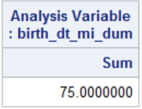
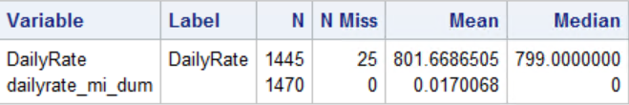
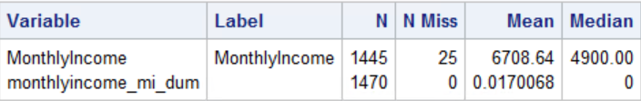
Missing Values
In the data set we have missing values for DEPART_DT, BIRTH_DT, DAILYRATE, MONTHLYINCOME, and BIRTH_STATE. MARITALSTATUS.
BIRTH_DT – In slide10 table, BIRTH_DT has missing number is 75 & missing values (1.54%) and, there is no evidence to find why it is missing, hence missing indicator is used. The sum of the missing indicator is same as NMISS in the table.
DEPART_DT – In slide10 table, DEPART_DT has missing numbers 1233& missing values (25.33%) and, there is no evidence to find why it is missing, hence a missing indicator is used.
Solving the issue of missing values using: -
1. Segmentation Imputation
2. Mean/Median Imputation
Step1: Replace the missing values with the mean/median value of a variable.
Step2: Changing the magnitude of correlation between imputed and other variables.
Step3: The variation in the imputed variable is reduces (i.e. variance value).
Daily Rate MONTHLYINCOME

Slide 12
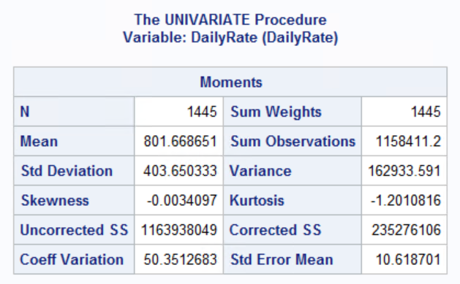
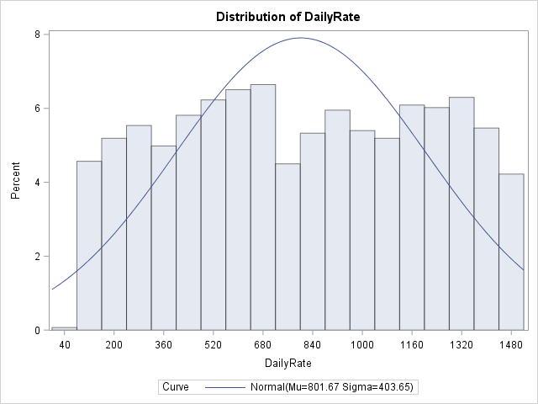
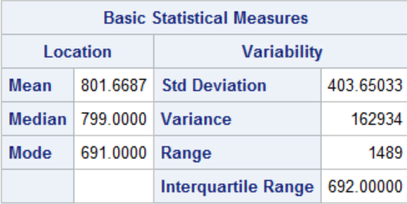
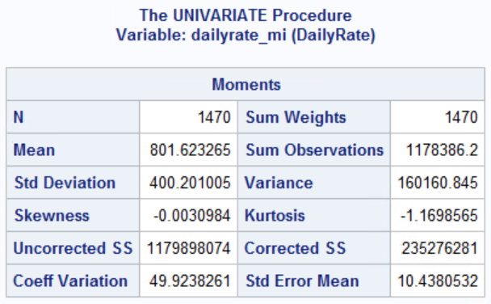
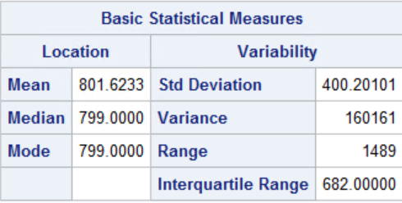
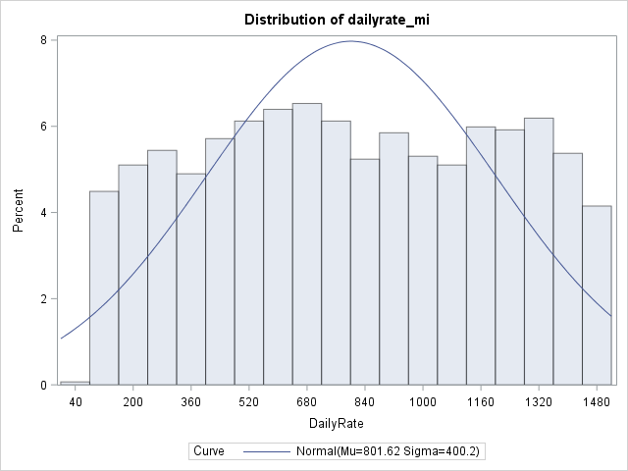
Missing Values
Median Imputation –
DailyRate – In slide10 table, DailyRate has missing numbers (25) & missing values (0.51%). There is no evidence to find why they are missing, hence a missing indicator is used. After the imputation, there are no more missing numbers. We used PROC STDIZE to impute the median value, but it did not yield much improvement (shown below). This is the reason why the two findings (before and after) for DailyRate are almost identical (799.00 vs. 799.00). We can see a small change before and after median imputation in the before and after variance (162934 & 160161) respectively.
Before
After

Slide 13
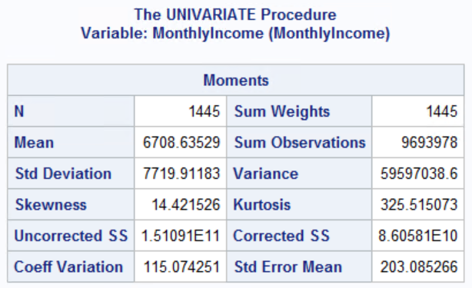
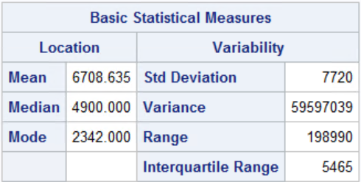
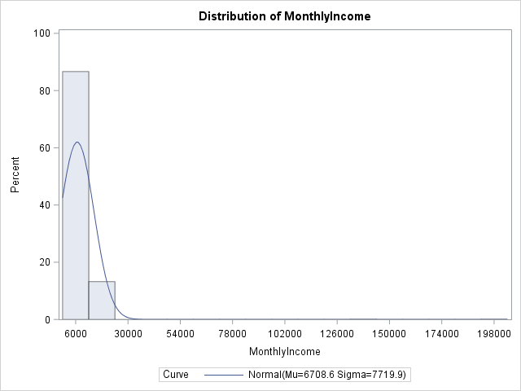
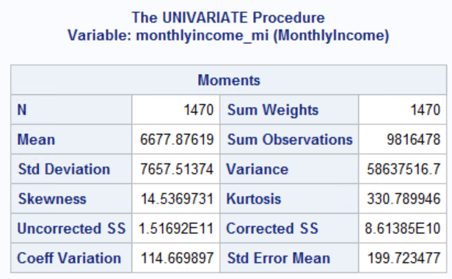
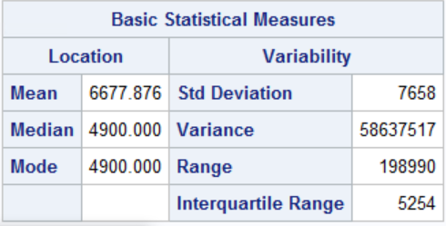
Missing Values
MONTHLYINCOME – In slide10 table, MONTHLYINCOME has 25 missing numbers & missing values (0.51%) and, there is no evidence to find why it is missing, hence a missing indicator was used. After the imputation there are 0 missing numbers. We used PROC STDIZE to impute the median value, but it also does not yield much improvement (shown below). This is the reason why the two findings (before and after) for monthlyincome are almost identical (4900 vs. 4900). We can see small change in before and after median imputation as the variance changed from 58637517 & 59597039.
B
Before
After

Slide 14
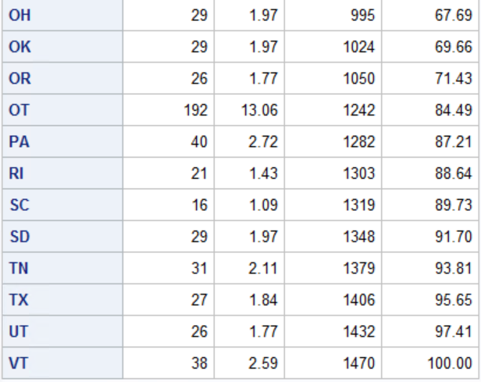
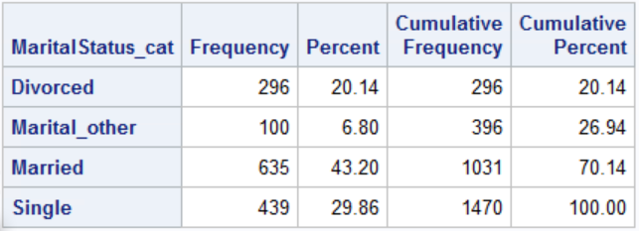
Missing Values
Missing values for categorical variables :
• Using PROC FREQ for BIRTH_ STATE we can see that it is missing in 192 cases.
• Using PROC MEANS for MARITALSTATUS we see it is missing in 100 cases.
The easiest way to account for these is to create a categorical variable for the missing cases. For example, when BIRTH_STATE is missing, call it “OT” for “other.” For example, we created a new variable called STATE_CAT which has the same values as BIRTH_STATE except for the new value “OT” which, as shown below, and has the same frequency as the missing values for BIRTH_STATE (Shown in the left):
Likewise, we created new variables MARITALSTATUS with the new values Marital_other representing the missing values (Shown in the right):
BIRTH_ STATE
MARITALSTATUS

Slide 15
Extreme Value
Extreme Value – An extreme value, or extremum (plural extrema), is the minimum or maximum value of a function, either in an arbitrarily small neighborhood of a point in the function's domain, in which case it is called a relative or local extremum. We used “PROC UNIVARIATE” statement to find extreme values of all variables. The extreme value or outliers can be resolved by following methods:-
1) Range Checking – Simple range check what should be reasonable max and min should be. We used put statement to converts numeric to character. Syntax we used to find the range:- PROC UNIVARIATE data=<filename> options;
VAR <var name>;
BY <var name>;
WHERE <condition>;
HISTOGRAM options; RUN;
2) Top/Bottom N – Several ways that we can find the top n% and bottom n% of data values based on a numeric variable. We used PROC UNIVARIATE statement to find cutoff values.
3) Standard Deviation – A standard deviation value close to 0 indicates that the data points tend to be very close to the mean of the data set and a high standard deviation indicates that the data points are spread out over a wider range of values. In SAS the SD values is measured using PROC MEAN statement.
4) Trimmed Stats – We used PROC RANKS to group the analysis variable into n groups.
5) IQR – Interquartile range = distance between the 25th and 75th percentile of the data. We used PROC MEANS statement to find the IQR.
6) Clustering – The goal of clustering is to partition data into groups so that the observations within a group are as similar as possible to each other, and as dissimilar as possible to the observations in other groups. We used PROC FASTCLUS statement to group obs into n clusters.

Slide 16
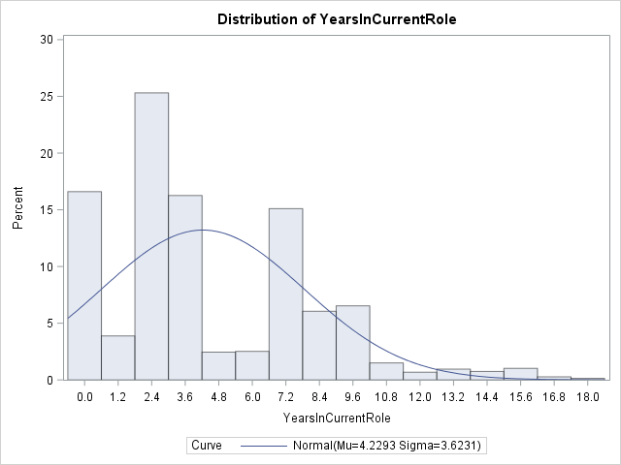
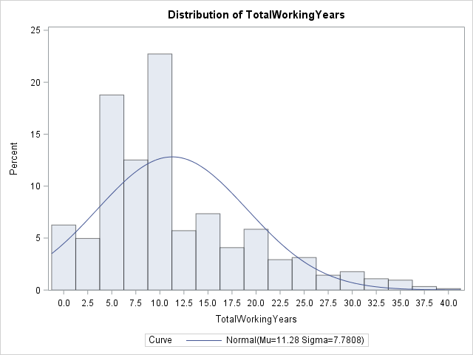
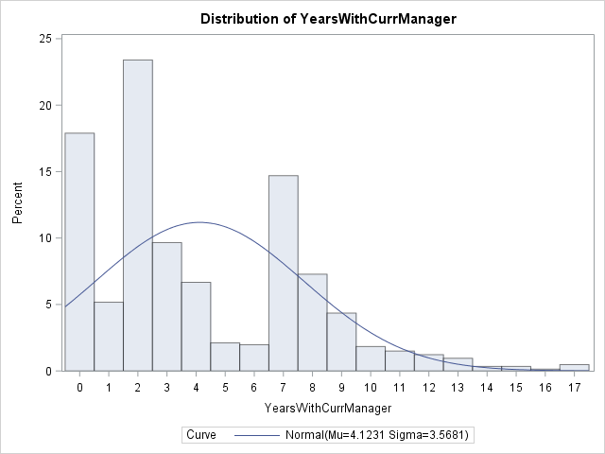
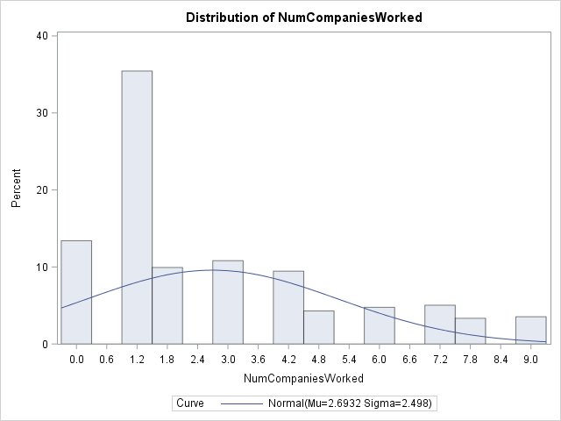
Extreme Values
Checking extreme values from histogram
List | Variable | Histogram
1 | YEARSINCURRENTROLE
2 | TOTALWORKINGYEARS
3 | YEARSWITHCURRMANAGER
4 | NUMCOMPANIESWORKED

Slide 17
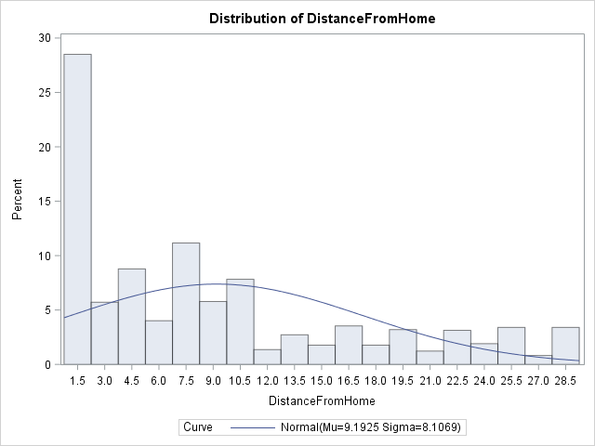
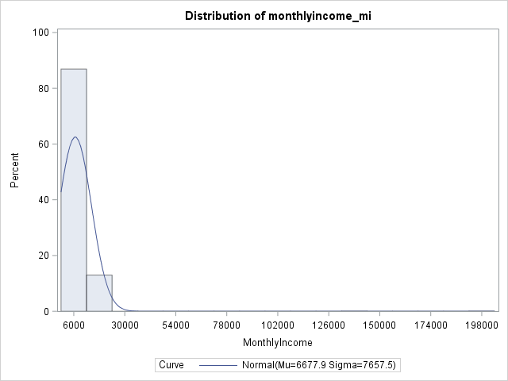
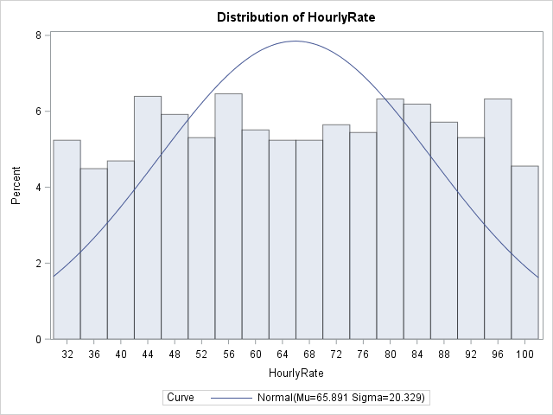
Extreme Values
Checking extreme values from histogram
List | Variable | Histogram
5 | DISTANCEFROMHOME
6 | MONTHLYINCOME_MI
7 | DAILYRATE_MI
8 | HOURLYRATE

Slide 18
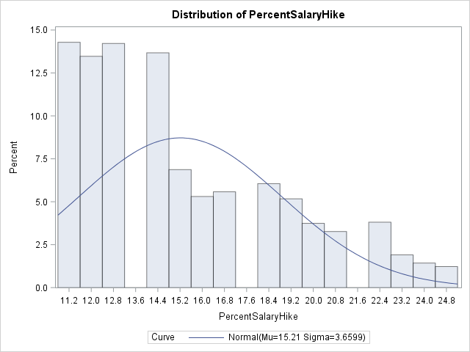
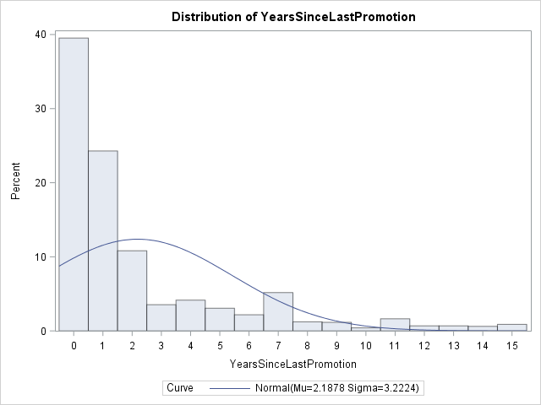
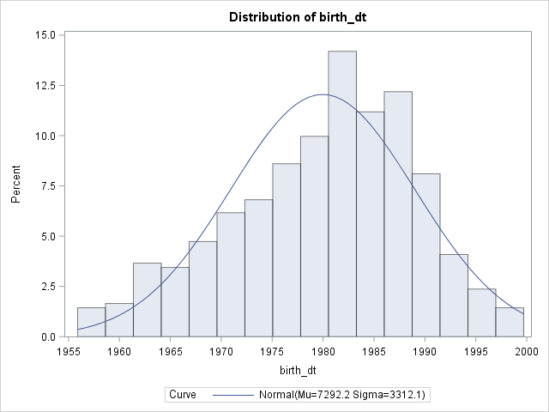
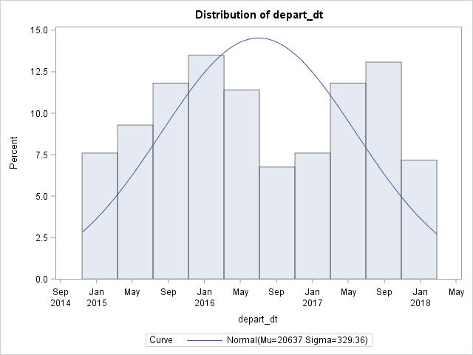
Extreme Values
Checking extreme values from histogram
List | Variable | Histogram
9 | PERCENTSALARYHIKE
10 | YEARSSINCELASTPROMOTION
11 | BIRTH_DT
12 | DEPART_DT

Slide 19
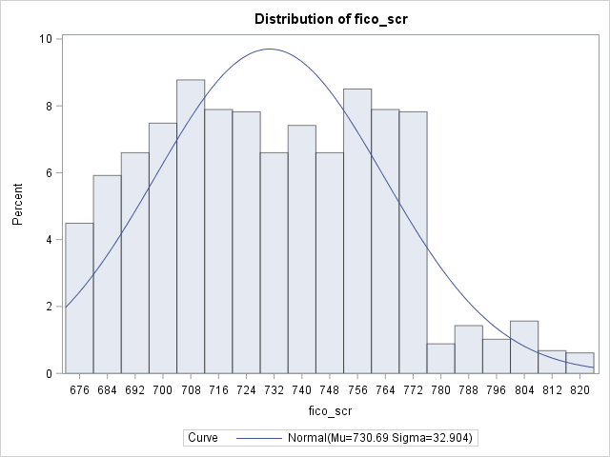
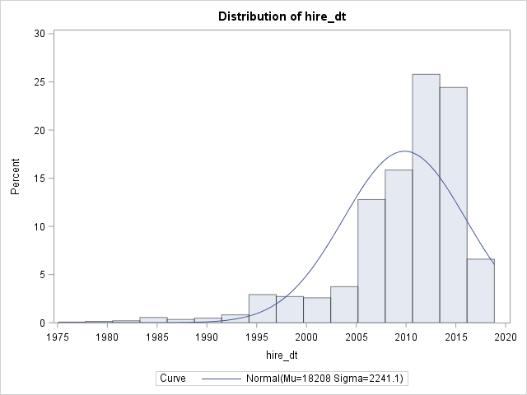
Extreme Values
Checking extreme values from histogram
List | Variable | Histogram
13 | FICO
14 | HIRE_DT

Slide 20
Extreme Values
MONTHLYINCOME_MI
Outlier ID Technique | Benchmarks Used | Outlier Values ID'd | Notes
Range checking | >= 20,000 | 2 values: $135,999, $199,999 | Its too high for normal employee to earn.
Top/bottom N | 1% | 30 value: < = 1,393, $19,636-$19,973, $135,999 and $199,999 | 1% too high
Standard deviation | 2 std | 2 values: $135,999, $199,999 | Too many, 1STD YEILDS 139 VALUES ge $1,433
Trimmed stats | 5% top and bottom, 2std | 132 values: greater than equal to $15,379 | too many
IQR | 3*IQR | 123 values | Too many, include >$16,070; Using multiple 3 yields 2 values > $23,951
Clustering | .007% of file size | 2 values: $135,999 and $199,999 | Too few, 2 extreme less than 0.070% of the file size, but others are more than 0.20%
Examining the raw distribution of this variable suggests that values above $100 may be extreme.

Slide 21
Extreme Values
DAILYRATE_MI
Outlier ID Technique | Benchmarks Used | Outlier Values ID'd | Notes
Range checking | <= 100 | 1 values: = $10.2 | Based on definition, it's impossible to earn only very less per day.
Top/bottom N | 1% | 33 values = $10.2, $103-$117, and $1,485-$1,499 | Too many, include >$1,485
Standard deviation | 2std | 0 value | Too high, includes using 1std yields 611 values >=$1202 and <=$401
Trimmed stats | 5% top and bottom, 1std | 523 values | Too many, using 1std /top and bottom5% yields 0 values
IQR | 3*IQR | 0 values | Multiple 3 fails; focus on the low side multiple 1 yields 28 values <=$128 (lower469-2*IQR682) ; multiple 0.6 yields 1 values <=$59.8
Clustering | 0.07% of the files | 1 values: = $10.2 | Too few
Examining the raw distribution of this variable suggests that values above $100 may be extreme.

Slide 22
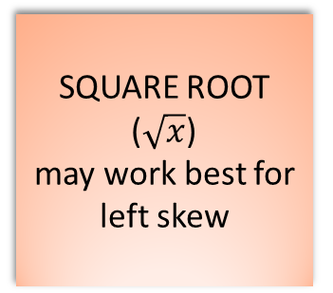
Extreme Distributions
Extreme distribution - Models built on inputs with extreme distributions attempt to optimize fit for the most extreme points at the cost of fit for the bulk of the data, usually near the input mean. The value are calculated on skewness value, if the skewness value is less than 5 then distribution is normally distributed but if distribution is more than 5 then distribution is not normal. To solve this issue different types of transformations are used to find the best fit.
TRANSFORMATIONS
SQUARE (X ²)
(Good for reducing left skewness, and can fit a response for quadratic function)
LOG (log(x))
may work best for right skew
INVERSE OF SQUARE ROOT (good to obtain a left truncated normal distribution)
SQUARE ROOT ($\sqrt{x}$)
may work best for left skew
INVERSE (1/x) (works best for flat distributions)
INVERSE OF SQUARE
(can be used for non-zero data)

Slide 23
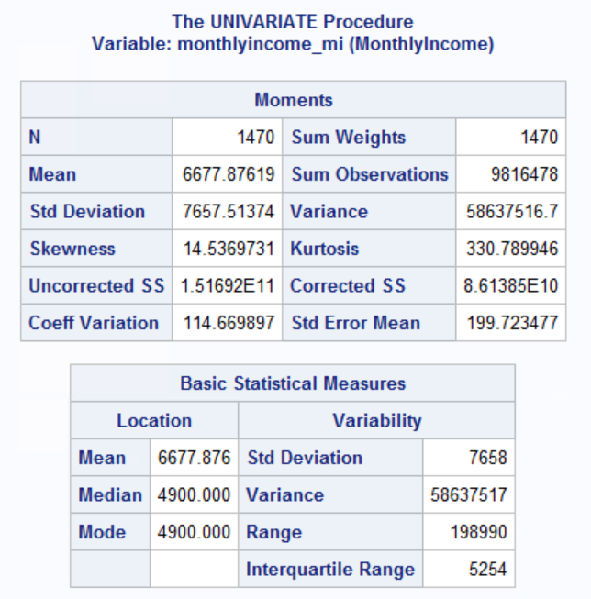
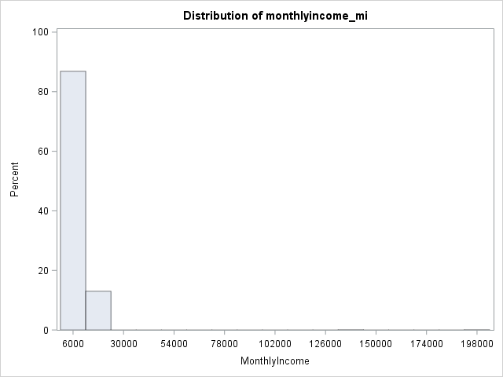
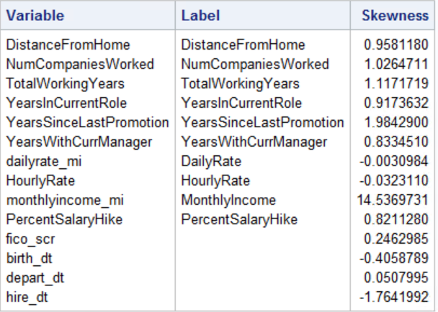
Extreme Distribution
All the attributes skewness value are less than 5, except monthlyincome_mi where skewness value is 14.54.
Skewness value more than 5 which is highly skewed
MONTHLYINCOME_MI with extreme distribution
MONTHLYINCOME_MI Moments and Basic Statistic

Slide 24
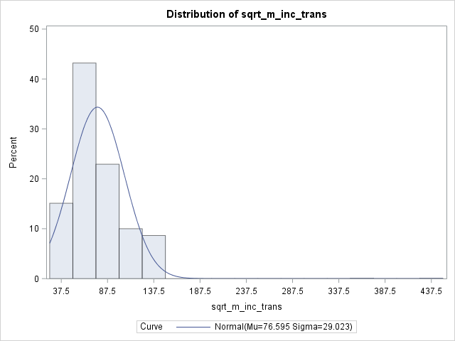
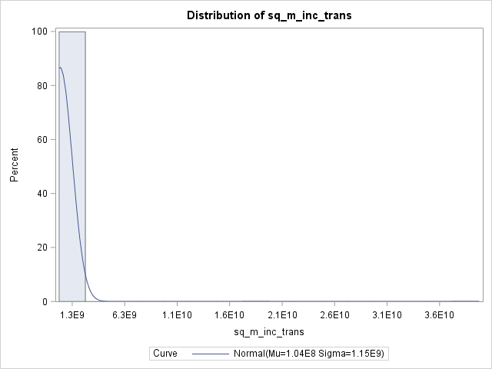
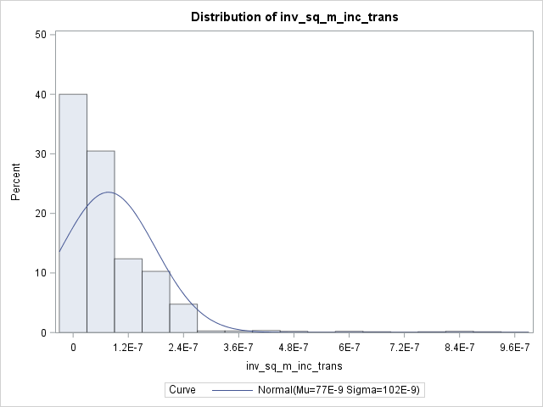
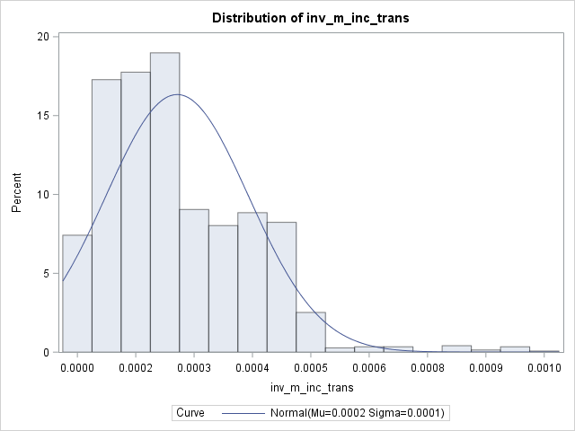
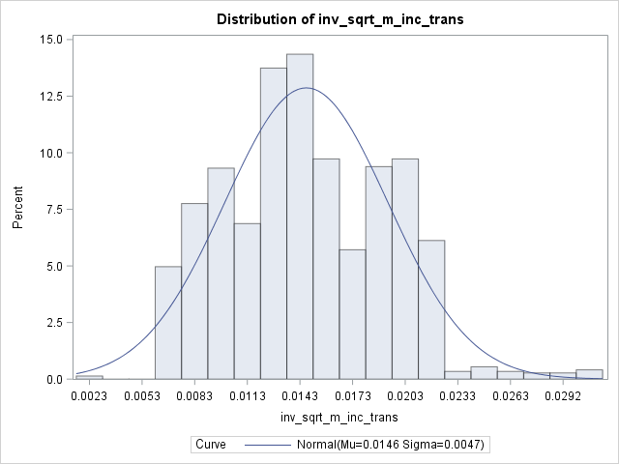
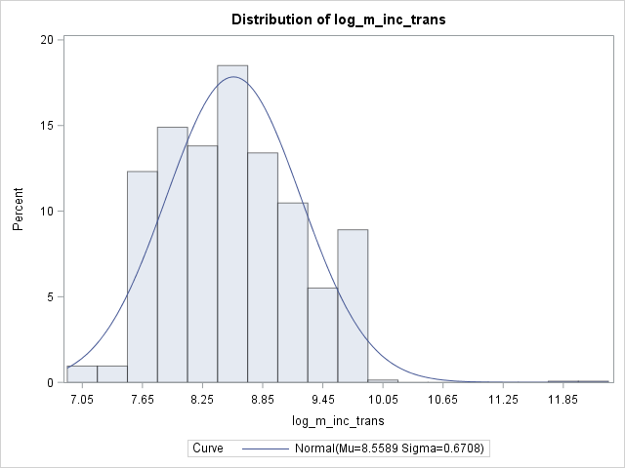
Extreme Distribution
Transformations:-
Transformation | Skewness Value
Square Root | 2.7204540
Square | 31.1934842
Log | 0.4307912
Inverse | 1.2003363
Inverse Square Root | 0.3649125
Inverse Square | 3.8553715
Square root Transformation
Log Transformation

Slide 25
Feature Engineering
Once the raw data are cleaned, create new variables that may be useful in your model. Consider both non-numeric and numeric variables.
Categorical variable preparation:
Cardinality - Cardinality is the number of distinct levels of a categorical variable. Low, mid and high cardinality inputs require different transformation strategies.
The cardinality ratio calculated in general guidelines:
CR > 0.5 => continuous variable
CR < 0.5 => discrete variable
CR closer to 1 => high cardinality
CR closer to 0 => low cardinality
simple dummy coding – For low and mid cardinality variables, we can recode them into “dummy variables”.
Threshold dummy coding
Level reduction using clustering
Enumeration
Linking

Slide 26
Feature Engineering
Date Value –
Variable | N | N Miss | Mean | Minimum | Maximum
AGE | 1395 | 75 | 38.4544803 | 19 | 62
YEARSINCELEFTCOMPANY | 237 | 1233 | 1.907173 | 0 | 3
TOTAL_NUMYEARWORK | 1470 | 0 | 8.2557823 | 0 | 40

Slide 27
Feature Engineering
Cardinality for all the variables
LIST | CATEGORICAL VARIABLE | VAR TYPE | NO OF LEVEL | Cardinality ratio | Cardinality level
1 | birth_state_cat | Char | 47 | 0.032 | low cardinality
2 | educationfield_1 | Char | 6 | 0.004 | low cardinality
3 | education | Num | 5 | 0.003 | low cardinality
4 | joblevel | Num | 5 | 0.003 | low cardinality
5 | environmentsatisfaction | Num | 4 | 0.003 | low cardinality
6 | jobinvolvement | Num | 4 | 0.003 | low cardinality
7 | jobsatisfaction | Num | 4 | 0.003 | low cardinality
8 | maritalstatus_cat | Char | 4 | 0.0003 | low cardinality
9 | relationshipsatisfaction | Num | 4 | 0.003 | low cardinality
10 | stockoptionlevel | Num | 4 | 0.003 | low cardinality
11 | worklifebalance | Num | 4 | 0.003 | low cardinality
12 | department_1 | Char | 3 | 0.002 | low cardinality
13 | businesstravel | Char | 3 | 0.002 | low cardinality

Slide 28
Feature Engineering
LIST | CATEGORICAL VARIABLE | VAR TYPE | NO OF LEVEL | Cardinality ratio | Cardinality level
14 | gender | Char | 3 | .002040816 | low cardinality
15 | overtime | Char | 2 | .001360544 | low cardinality
16 | performancerating | Num | 2 | .001360544 | low cardinality
17 | employee_attr | Num | 2 | .001360544 | low cardinality
18 | employ_1 | Num | 2 | .001360544 | low cardinality
19 | monthlyincome_mi_dum | Num | 2 | .001360544 | low cardinality
20 | birth_dt_mi_dum | Num | 2 | .001360544 | low cardinality
21 | dailyrate_mi_dum | Num | 2 | .001360544 | low cardinality
22 | dailyrate_outlier | Num | 2 | .001360544 | low cardinality
23 | hire_dt_outlier | Num | 2 | .001360544 | low cardinality
24 | monthlyincome_outlier | Num | 2 | .001360544 | low cardinality
25 | took_survey | Num | 1 | .000680272 | low cardinality

Slide 29
Feature Engineering
Dummy Threshold coding for all the categorical variables
VARIABLE | MINIMUM | MEAN | MAXIMUM | TOTAL SUM | (Employ_1 = 0) | (Employ_1= 1)
Ed1_dum | 0 | 0.1156463 | 1 | 170 | 139 | 31
Ed2_dum | 0 | 0.1918367 | 1 | 282 | 238 | 44
Ed3_dum | 0 | 0.3891156 | 1 | 572 | 473 | 99
Ed4_dum | 0 | 0.2707483 | 1 | 398 | 340 | 58
Ed5_dum | 0 | 0.0326531 | 1 | 48 | 43 | 5
Ef_HR_dum | 0 | 0.0183673 | 1 | 27 | 20 | 7
Ef_LS_dum | 0 | 0.4122449 | 1 | 606 | 517 | 89
Ef_M_dum | 0 | 0.1081633 | 1 | 159 | 124 | 35
Ef_Med_dum | 0 | 0.3156463 | 1 | 464 | 401 | 63
Ef_O_dum | 0 | 0.0557823 | 1 | 82 | 71 | 11
Ef_tech_dum | 0 | 0.0897959 | 1 | 132 | 100 | 32
jl1_dum | 0 | 0.3693878 | 1 | 543 | 400 | 143
jl2_dum | 0 | 0.3632653 | 1 | 534 | 482 | 52
jl3_dum | 0 | 0.1482993 | 1 | 218 | 186 | 32
jl4_dum | 0 | 0.0721088 | 1 | 106 | 101 | 5

Slide 30
Feature Engineering
VARIABLE | MINIMUM | MEAN | MAXIMUM | TOTAL SUM | (Employ_1 = 0) | (Employ_1= 1)
jl5_dum | 0 | 0.0469388 | 1 | 69 | 64 | 5
Depart_HR_dum | 0 | 0.0428571 | 1 | 63 | 51 | 12
Depart_R_dum | 0 | 0 | 0 | 0 | 828 | 133
Depart_S_dum | 0 | 0.3034014 | 1 | 446 | 354 | 92
ES1_dum | 0 | 0.1931973 | 1 | 284 | 212 | 72
ES2_dum | 0 | 0.1952381 | 1 | 287 | 244 | 43
ES3_dum | 0 | 0.3081633 | 1 | 453 | 391 | 62
ES4_dum | 0 | 0.3034014 | 1 | 446 | 386 | 60
JI1_dum | 0 | 0.0564626 | 1 | 83 | 55 | 28
JI2_dum | 0 | 0.255102 | 1 | 375 | 304 | 71
JI3_dum | 0 | 0.5904762 | 1 | 868 | 743 | 125
JI4_dum | 0 | 0.0979592 | 1 | 144 | 131 | 13
JS1_dum | 0 | 0.1965986 | 1 | 289 | 223 | 66
JS2_dum | 0 | 0.1904762 | 1 | 280 | 234 | 46
JS3_dum | 0 | 0.3006803 | 1 | 442 | 369 | 73

Slide 31
Feature Engineering
VARIABLE | MINIMUM | MEAN | MAXIMUM | TOTAL SUM | (Employ_1 = 0) | (Employ_1= 1)
JS4_dum | 0 | 0.3122449 | 1 | 459 | 407 | 52
Marital_D_dum | 0 | 0.2013605 | 1 | 296 | 266 | 30
Marital_M_dum | 0 | 0.4319728 | 1 | 635 | 555 | 80
Marital_S_dum | 0 | 0.2986395 | 1 | 439 | 324 | 115
RS1_dum | 0 | 0.1877551 | 1 | 276 | 219 | 57
RS2_dum | 0 | 0.2061224 | 1 | 303 | 258 | 45
RS3_dum | 0 | 0.3122449 | 1 | 459 | 388 | 71
RS4_dum | 0 | 0.2938776 | 1 | 432 | 368 | 64
SOL0_dum | 0 | 0.4292517 | 1 | 631 | 477 | 154
SOL1_dum | 0 | 0.4054422 | 1 | 596 | 540 | 56
SOL2_dum | 0 | 0.107483 | 1 | 158 | 146 | 12
SOL3_dum | 0 | 0.0578231 | 1 | 85 | 70 | 15
WLB1_dum | 0 | 0.0544218 | 1 | 80 | 55 | 25
WLB2_dum | 0 | 0.2340136 | 1 | 344 | 286 | 58
WLB3_dum | 0 | 0.607483 | 1 | 893 | 766 | 127

Slide 32
Feature Engineering
VARIABLE | MINIMUM | MEAN | MAXIMUM | TOTAL SUM | (Employ_1 = 0) | (Employ_1= 1)
WLB4_dum | 0 | 0.1040816 | 1 | 153 | 126 | 27
BT_TF_dum | 0 | 0.1884354 | 1 | 277 | 208 | 69
BT_TR_dum | 0 | 0.7095238 | 1 | 1043 | 887 | 156
BT_NT_dum | 0 | 0.1020408 | 1 | 150 | 138 | 12
gender_F_dum | 0 | 0.3673469 | 1 | 540 | 458 | 82
gender_M_dum | 0 | 0.5646259 | 1 | 830 | 687 | 143
gender_N_dum | 0 | 0.0680272 | 1 | 100 | 88 | 12
OverTime_Yes_dum | 0 | 0.2829932 | 1 | 416 | 289 | 127
OverTime_No_dum | 0 | 0.7170068 | 1 | 1054 | 944 | 110
PR3_dum | 0 | 0.8462585 | 1 | 1244 | 1044 | 200
PR4_dum | 0 | 0.1537415 | 1 | 226 | 189 | 37
BS_AK_dum | 0 | 0.0183673 | 1 | 27 | 21 | 6
BS_AL_dum | 0 | 0.0204082 | 1 | 30 | 26 | 4
BS_AR_dum | 0 | 0.014966 | 1 | 22 | 16 | 6
BS_AZ_dum | 0 | 0.0142857 | 1 | 21 | 18 | 3

Slide 33
Feature Engineering
VARIABLE | MINIMUM | MEAN | MAXIMUM | TOTAL SUM | (Employ_1 = 0) | (Employ_1= 1)
BS_CA_dum | 0 | 0.0170068 | 1 | 25 | 20 | 5
BS_CO_dum | 0 | 0.014966 | 1 | 22 | 19 | 3
BS_CT_dum | 0 | 0.0170068 | 1 | 25 | 24 | 1
BS_DC_dum | 0 | 0.0190476 | 1 | 28 | 26 | 2
BS_DE_dum | 0 | 0.0170068 | 1 | 25 | 20 | 5
BS_FL_dum | 0 | 0.0176871 | 1 | 26 | 22 | 4
BS_GA_dum | 0 | 0.0156463 | 1 | 23 | 17 | 6
BS_HI_dum | 0 | 0.0115646 | 1 | 17 | 11 | 6
BS_IA_dum | 0 | 0.0204082 | 1 | 30 | 24 | 6
BS_ID_dum | 0 | 0.0210884 | 1 | 31 | 26 | 5
BS_IL_dum | 0 | 0.0163265 | 1 | 24 | 19 | 5
BS_IN_dum | 0 | 0.0204082 | 1 | 30 | 25 | 5
BS_KS_dum | 0 | 0.0231293 | 1 | 34 | 27 | 7
BS_KY_dum | 0 | 0.022449 | 1 | 33 | 29 | 4
BS_LA_dum | 0 | 0.0217687 | 1 | 32 | 27 | 5

Slide 34
Feature Engineering
VARIABLE | MINIMUM | MEAN | MAXIMUM | TOTAL SUM | (Employ_1 = 0) | (Employ_1= 1)
BS_MA_dum | 0 | 0.0210884 | 1 | 31 | 27 | 4
BS_MD_dum | 0 | 0.0231293 | 1 | 34 | 31 | 3
BS_ME_dum | 0 | 0.0183673 | 1 | 27 | 24 | 3
BS_MI_dum | 0 | 0.0197279 | 1 | 29 | 25 | 4
BS_MN_dum | 0 | 0.0163265 | 1 | 24 | 23 | 1
BS_MO_dum | 0 | 0.0163265 | 1 | 24 | 20 | 4
BS_MS_dum | 0 | 0.0204082 | 1 | 30 | 25 | 5
BS_MT_dum | 0 | 0.0238095 | 1 | 35 | 32 | 3
BS_NC_dum | 0 | 0.0204082 | 1 | 30 | 24 | 6
BS_ND_dum | 0 | 0.0102041 | 1 | 15 | 14 | 1
BS_NE_dum | 0 | 0.0163265 | 1 | 24 | 23 | 1
BS_NH_dum | 0 | 0.0176871 | 1 | 26 | 22 | 4
BS_NJ_dum | 0 | 0.0231293 | 1 | 34 | 29 | 5
BS_NM_dum | 0 | 0.0210884 | 1 | 31 | 28 | 3
BS_NV_dum | 0 | 0.0258503 | 1 | 38 | 31 | 7

Slide 35
Feature Engineering
VARIABLE | MINIMUM | MEAN | MAXIMUM | TOTAL SUM | (Employ_1 = 0) | (Employ_1= 1)
BS_NY_dum | 0 | 0.0197279 | 1 | 29 | 23 | 6
BS_OH_dum | 0 | 0.0197279 | 1 | 29 | 28 | 1
BS_OK_dum | 0 | 0.0197279 | 1 | 29 | 20 | 9
BS_OR_dum | 0 | 0.0176871 | 1 | 26 | 22 | 4
BS_PA_dum | 0 | 0.0272109 | 1 | 40 | 33 | 7
BS_RI_dum | 0 | 0.0142857 | 1 | 21 | 19 | 2
BS_SC_dum | 0 | 0.0108844 | 1 | 16 | 15 | 1
BS_SD_dum | 0 | 0.0197279 | 1 | 29 | 20 | 9
BS_TN_dum | 0 | 0.0210884 | 1 | 31 | 24 | 7
BS_TX_dum | 0 | 0.0183673 | 1 | 27 | 25 | 2
BS_UT_dum | 0 | 0.0176871 | 1 | 26 | 21 | 5
BS_VT_dum | 0 | 0.0258503 | 1 | 38 | 31 | 7
BS_OT_dum | 0 | 0.1306122 | 1 | 192 | 157 | 35

Slide 36
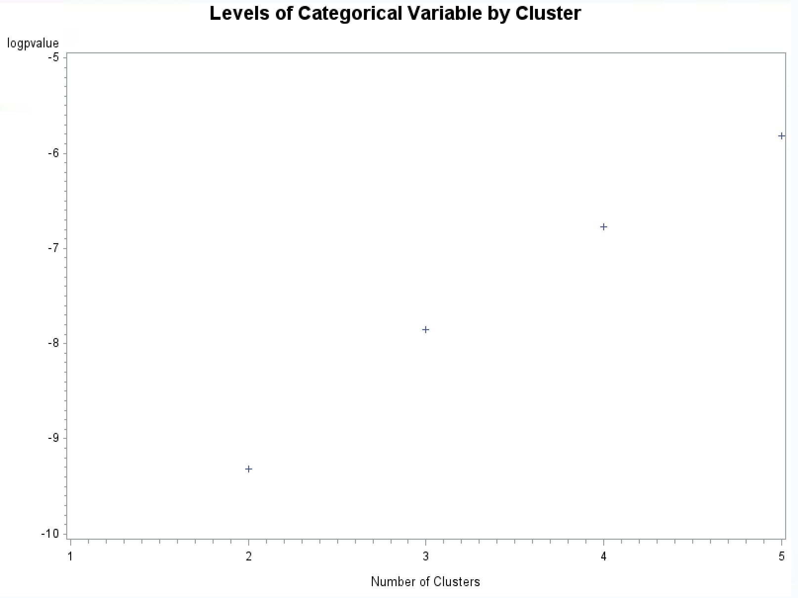
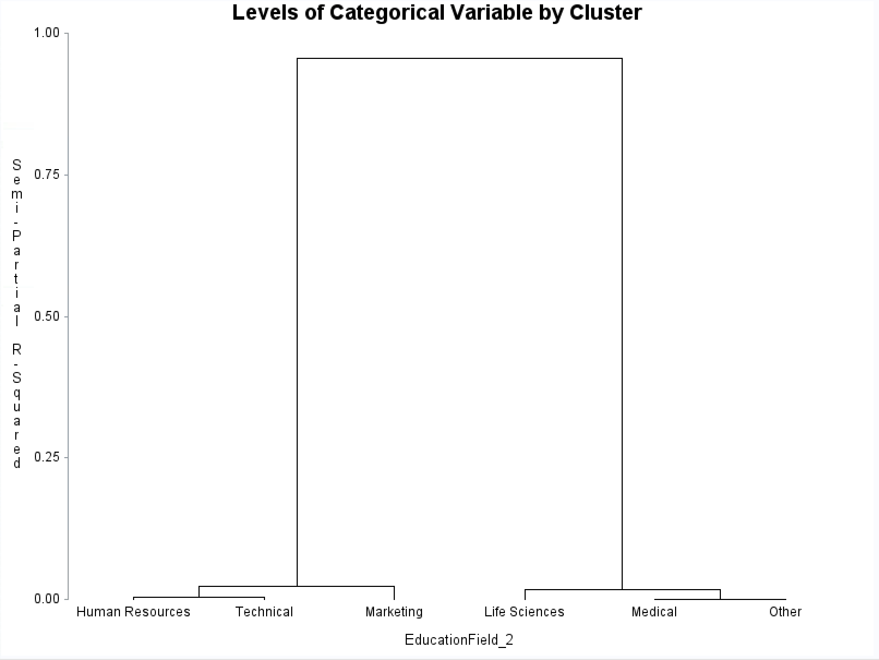
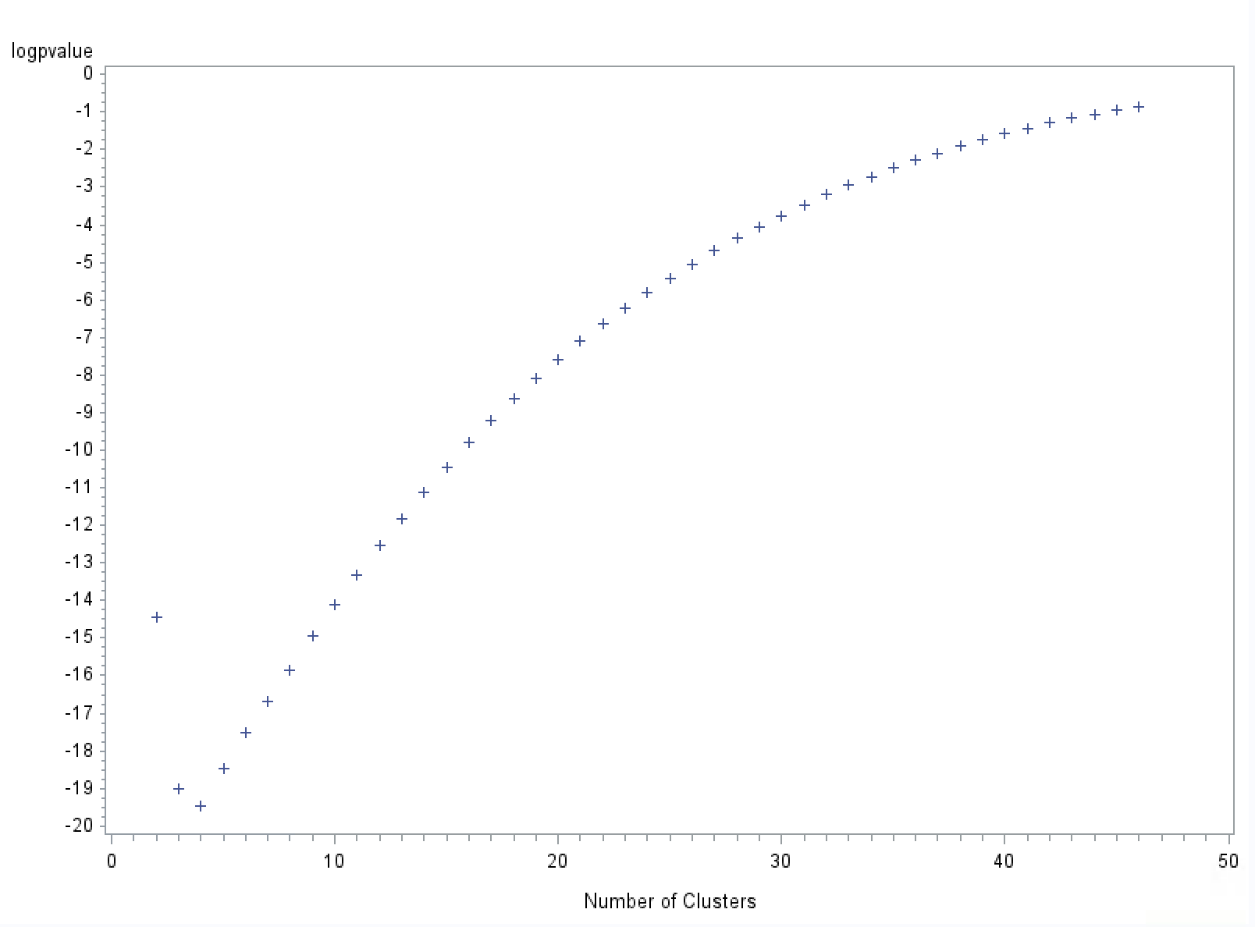
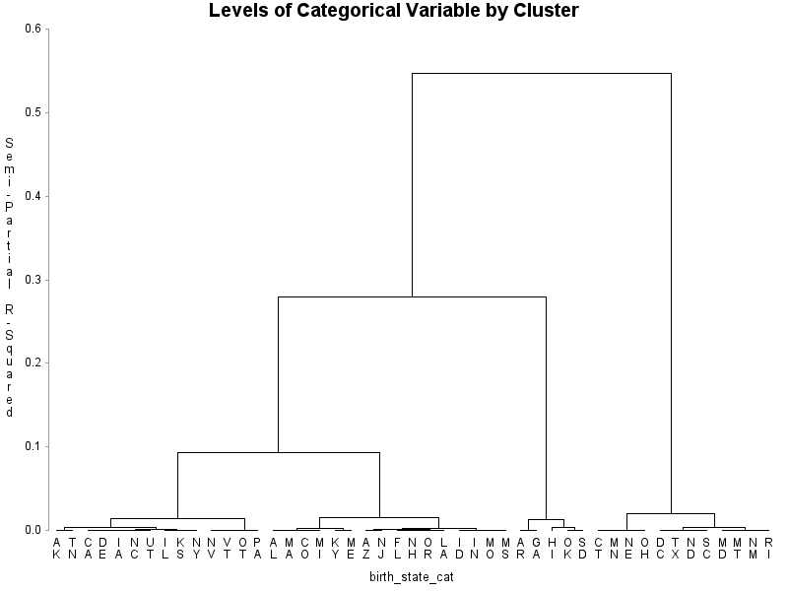
Feature Engineering
Clustering - Once variable clusters have been found, variable (dimension) reduction is achieved by replacing the original variables with a representative variable from each cluster. An ideal representative has high correlation with its own cluster and has a low correlation with the other clusters.
A metric that captures this is the 1-R2 Ratio
Chose the variable with the lowest 1-R2 Ratio
We used” PROC TREE” produces this tree chart (called a dendrogram). Typically, clusters are at the ends of long tree branches.
Plot the log p-values against number of clusters, to show at which cluster count is log of p-value a min or a max.
Plot and Dendogram of all the categorical variables
List | Variables | P-values log | dendrogram
1 | educationfield_1
2 | birth_state_cat

Slide 37
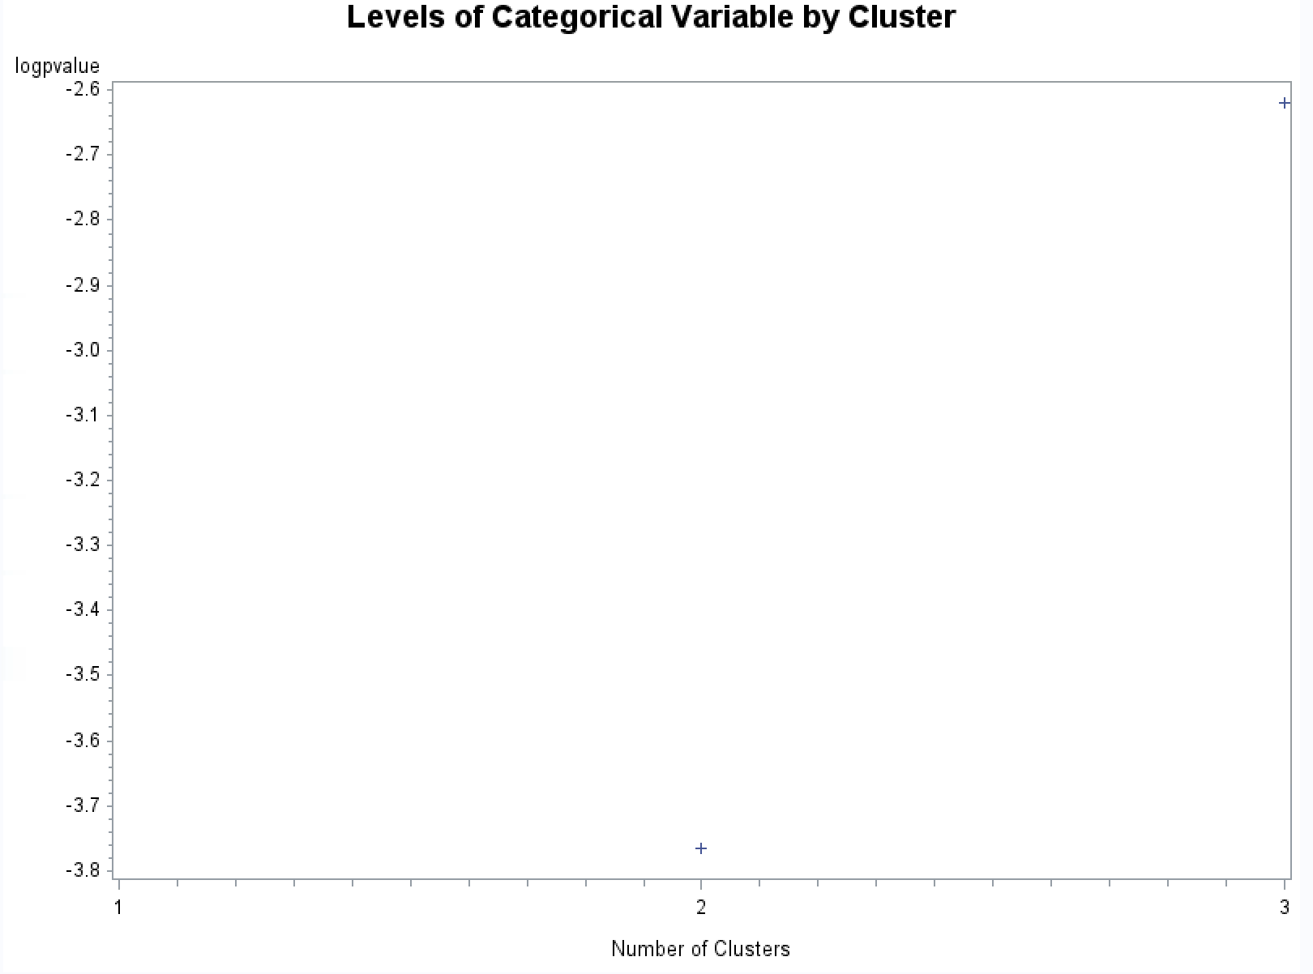
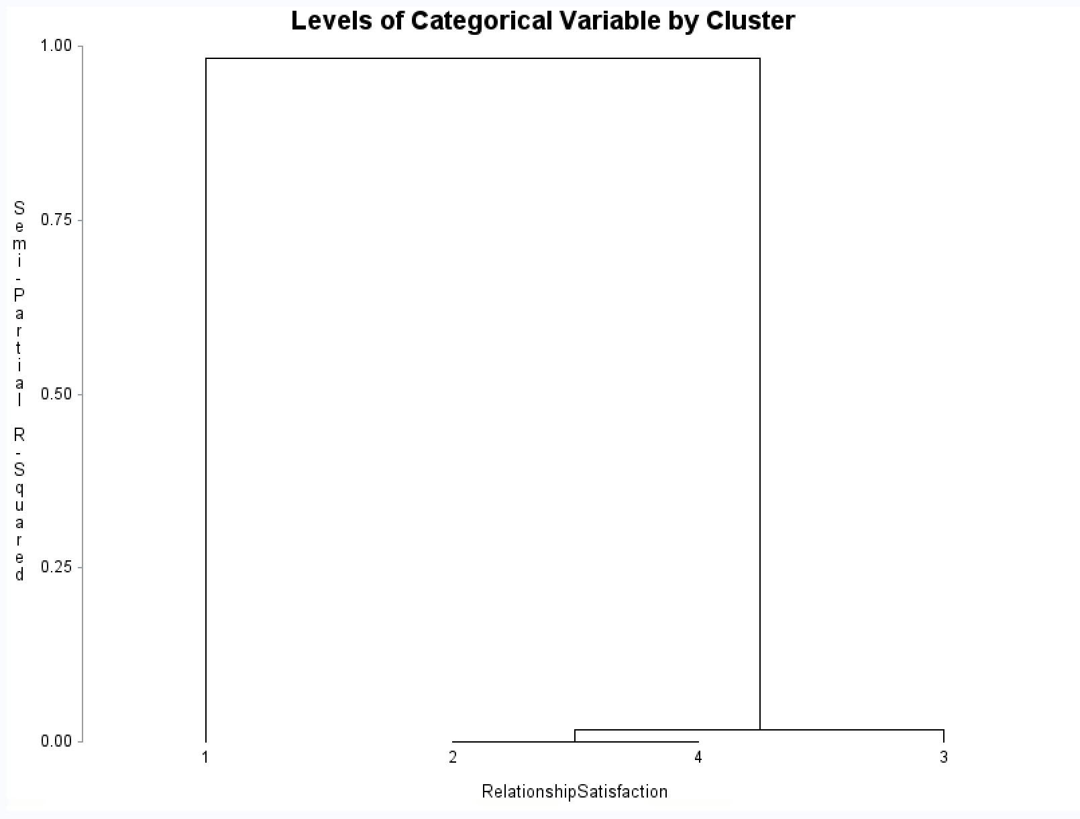
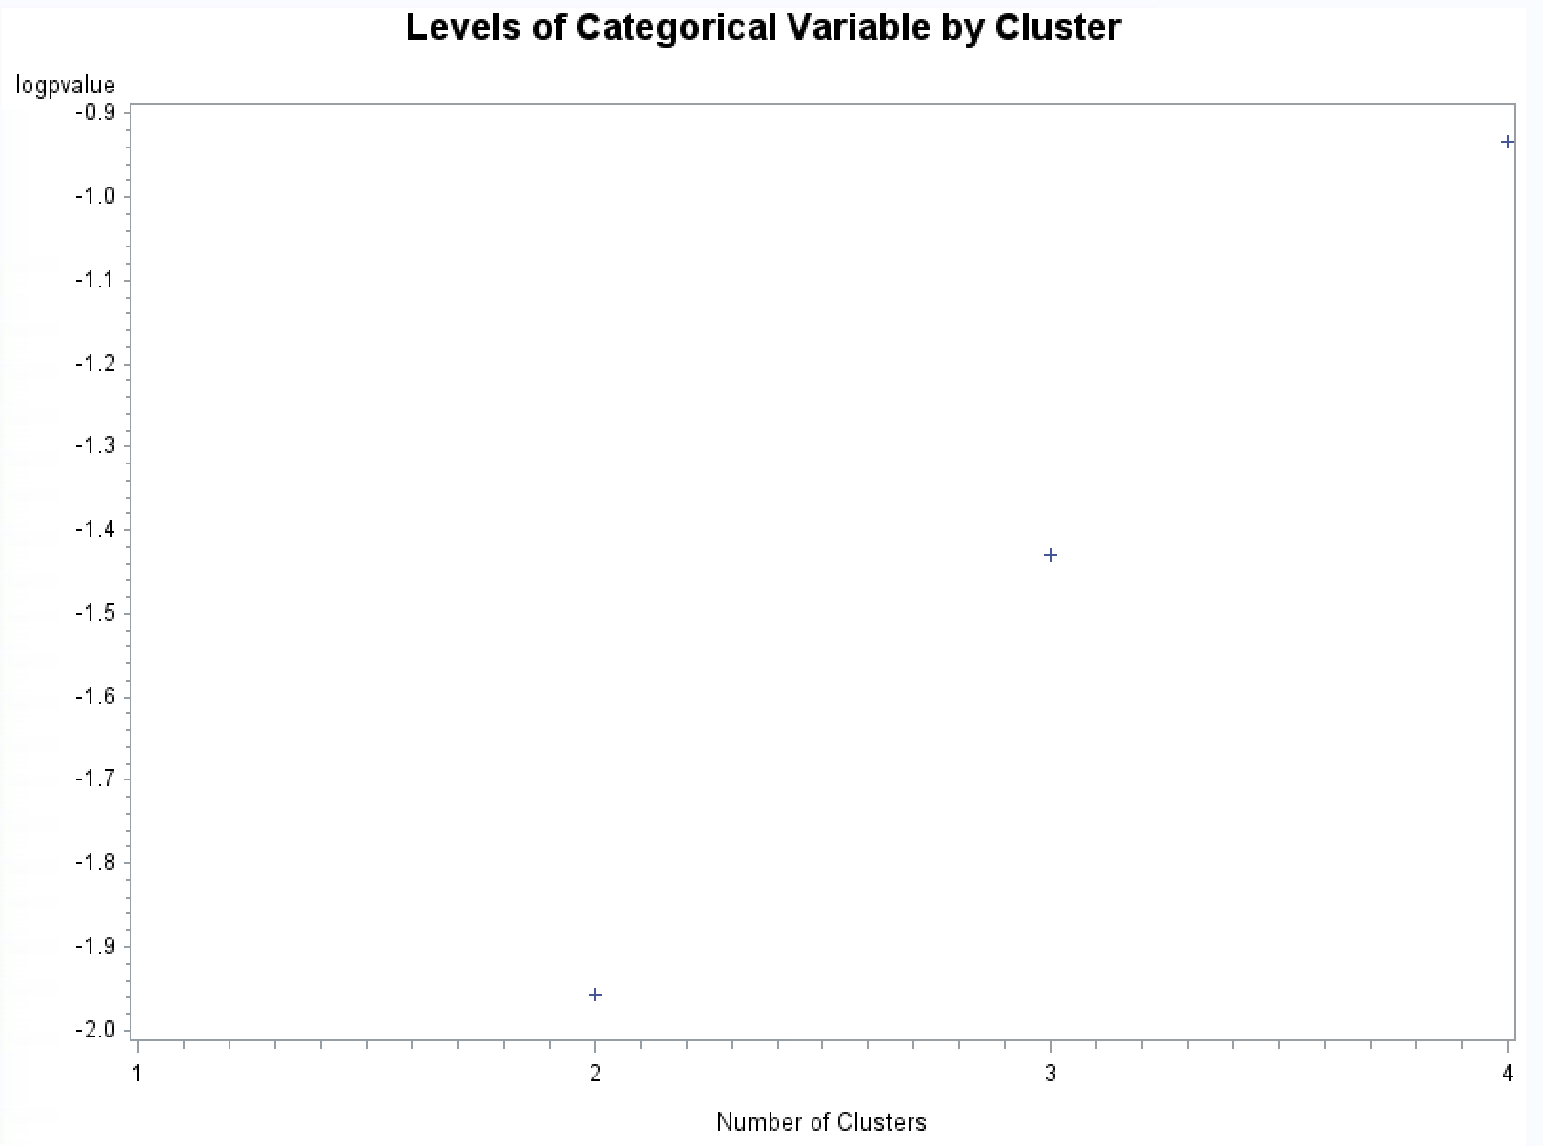
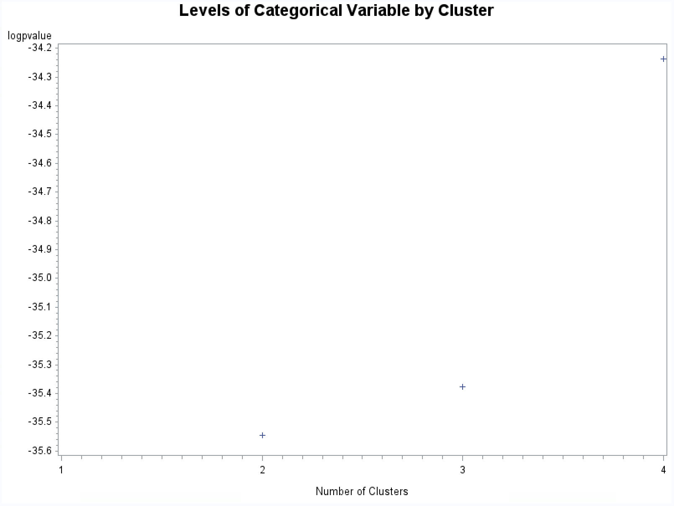

Feature Engineering
List | Variables | P-values log | dendrogram
3 | relationshipsatisfaction
4 | education
5 | joblevel

Slide 38





Feature Engineering
The 5 categorical variables number of clusters before and after, levels of clustering, frequency of 5 new dummy variables, New clusters with target variables –
Levels before and after collapsing levels
Variables | Before | After
educationfield_1 | 6
birth_state_cat | 47
relationshipsatisfaction | 4
education | 5
joblevel | 5

Slide 39










Feature Engineering
New clustering dummy Variables & frequency by Employ_1
List | Variables | Dummy Variables | BY target variable
1 | educationfield_1
2 | birth_state_cat
3 | relationshipsatisfaction
4 | education
5 | joblevel

Slide 40
Feature Engineering
Target Based Enumeration-
Birth_State-
birth_state_cat | frequency | events | non-events | % events | % non-events | WOE | IV
AK | 27 | 6 | 21 | 2.53% | 1.70% | 0.3964 | 0.0033
AL | 30 | 4 | 26 | 1.69% | 2.11% | -0.2227 | 0.0009
AR | 22 | 6 | 16 | 2.53% | 1.30% | 0.6683 | 0.0082
AZ | 21 | 3 | 18 | 1.27% | 1.46% | -0.1426 | 0.0003
CA | 25 | 5 | 20 | 2.11% | 1.62% | 0.2629 | 0.0013
CO | 22 | 3 | 19 | 1.27% | 1.54% | -0.1967 | 0.0005
CT | 25 | 1 | 24 | 0.42% | 1.95% | -1.5289 | 0.0233
DC | 28 | 2 | 26 | 0.84% | 2.11% | -0.9158 | 0.0116
DE | 25 | 5 | 20 | 2.11% | 1.62% | 0.2629 | 0.0013
FL | 26 | 4 | 22 | 1.69% | 1.78% | -0.0556 | 0.0001
GA | 23 | 6 | 17 | 2.53% | 1.38% | 0.6077 | 0.0070
HI | 17 | 6 | 11 | 2.53% | 0.89% | 1.0430 | 0.0171
IA | 30 | 6 | 24 | 2.53% | 1.95% | 0.2629 | 0.0015
ID | 31 | 5 | 26 | 2.11% | 2.11% | 0.0005 | 0.0000
IL | 24 | 5 | 19 | 2.11% | 1.54% | 0.3141 | 0.0018
IN | 30 | 5 | 25 | 2.11% | 2.03% | 0.0397 | 0.0000
KS | 34 | 7 | 27 | 2.95% | 2.19% | 0.2992 | 0.0023
KY | 33 | 4 | 29 | 1.69% | 2.35% | -0.3319 | 0.0022
LA | 32 | 5 | 27 | 2.11% | 2.19% | -0.0373 | 0.0000
MA | 31 | 4 | 27 | 1.69% | 2.19% | -0.2604 | 0.0013

Slide 41
Feature Engineering
birth_state_cat | frequency | events | non-events | % events | % non-events | WOE | IV
MD | 34 | 3 | 31 | 1.27% | 2.51% | -0.6862 | 0.0086
ME | 27 | 3 | 24 | 1.27% | 1.95% | -0.4303 | 0.0029
MI | 29 | 4 | 25 | 1.69% | 2.03% | -0.1834 | 0.0006
MN | 24 | 1 | 23 | 0.42% | 1.87% | -1.4864 | 0.0215
MO | 24 | 4 | 20 | 1.69% | 1.62% | 0.0397 | 0.0000
MS | 30 | 5 | 25 | 2.11% | 2.03% | 0.0397 | 0.0000
MT | 35 | 3 | 32 | 1.27% | 2.60% | -0.7180 | 0.0095
NC | 30 | 6 | 24 | 2.53% | 1.95% | 0.2629 | 0.0015
ND | 15 | 1 | 14 | 0.42% | 1.14% | -0.9899 | 0.0071
NE | 24 | 1 | 23 | 0.42% | 1.87% | -1.4864 | 0.0215
NH | 26 | 4 | 22 | 1.69% | 1.78% | -0.0556 | 0.0001
NJ | 34 | 5 | 29 | 2.11% | 2.35% | -0.1087 | 0.0003
NM | 31 | 3 | 28 | 1.27% | 2.27% | -0.5845 | 0.0059
NV | 38 | 7 | 31 | 2.95% | 2.51% | 0.1611 | 0.0007
NY | 29 | 6 | 23 | 2.53% | 1.87% | 0.3054 | 0.0020
OH | 29 | 1 | 28 | 0.42% | 2.27% | -1.6831 | 0.0311
OK | 29 | 9 | 20 | 3.80% | 1.62% | 0.8506 | 0.0185
OR | 26 | 4 | 22 | 1.68% | 1.78% | -0.0556 | 0.0001
OT | 192 | 35 | 157 | 14.77% | 12.73% | 0.1483 | 0.0030
PA | 40 | 7 | 33 | 2.95% | 2.68% | 0.0986 | 0.0003
RI | 21 | 2 | 19 | 0.84% | 1.54% | -0.6022 | 0.0042
SC | 16 | 1 | 15 | 0.42% | 1.22% | -1.0589 | 0.0084
SD | 29 | 9 | 20 | 3.80% | 1.62% | 0.8506 | 0.0185
TN | 31 | 7 | 24 | 2.95% | 1.95% | 0.4170 | 0.0042
TX | 27 | 2 | 25 | 0.84% | 2.03% | -0.8766 | 0.0104
UT | 26 | 5 | 21 | 2.11% | 1.70% | 0.2141 | 0.0009
VT | 38 | 7 | 31 | 2.95% | 2.51% | 0.1611 | 0.0007
Total | 1470 | 237 | 1233 | 100.00% | 100.00% |  | 0.2665

Slide 42
Feature Engineering
Education-
Eduactionfeild_1
Education | frequency | events | non-events | % events | % non-events | WOE | IV
1 | 170 | 31 | 139 | 13.08% | 11.27% | 0.1487 | 0.0027
2 | 282 | 44 | 238 | 18.57% | 19.30% | -0.0389 | 0.0003
3 | 572 | 99 | 473 | 41.77% | 38.36% | 0.0852 | 0.0029
4 | 398 | 58 | 340 | 24.47% | 27.58% | -0.1194 | 0.0037
5 | 48 | 5 | 43 | 2.11% | 3.49% | -0.5026 | 0.0069
Total | 1470 | 237 | 1233 | 100.00% | 100.00% |  | 0.0165
EducationField_1 | frequency | events | non-events | % events | % non-events | WOE | IV
Human Resources | 27 | 7 | 20 | 2.95% | 1.62% | 0.5993 | 0.0080
Life Sciences | 606 | 89 | 517 | 37.55% | 41.93% | -0.1103 | 0.0048
Marketing | 159 | 35 | 124 | 14.77% | 10.06% | 0.3842 | 0.0181
Medical | 464 | 63 | 401 | 26.58% | 32.52% | -0.2017 | 0.0120
Other | 82 | 11 | 71 | 4.64% | 5.76% | -0.2156 | 0.0024
Technical | 132 | 32 | 100 | 13.50% | 8.11% | 0.5097 | 0.0275
Total | 1470 | 237 | 1233 | 100.00% | 100.00% |  | 0.0728

Slide 43
Feature Engineering
model explaining Retain_q based on the variable-level IV
Variable | IV
OVERTIME | 0.4002
JOBLEVEL | 0.3842
STOCKOPTIONLEVEL | 0.3191
BIRTH_STATE_CAT | 0.2665
MARITALSTATUS_CAT | 0.2235
JOBINVOLVEMENT | 0.1259
BUSINESSTRAVEL | 0.1209
ENVIRONMENTSATISFACTION | 0.0999
JOBSATISFACTION | 0.0877
EDUCATIONFIELD_1 | 0.0728
WORKLIFEBALANCE | 0.0670
DEPARTMENT_1 | 0.0522
RELATIONSHIPSATISFACTION | 0.0245
EDUCATION | 0.0165
GENDER | 0.0126
PERFORMANCERATING | 0.0001

Slide 44

Feature Engineering
Interaction-
Interactions explains the relationship between the input and the target variables which differ by the level of another variable.
These are the variables helpful in further predictive modeling.

Slide 45
Extra Credit: Task #4

Slide 46
16 Clusters |  | R-squared with |  | 1-R**2 | Variable
Cluster | Variable | Own | Next | Ratio | Label
 |  | Cluster | Closest
Cluster 1 | hire_dt | 0.8185 | 0.5219 | 0.3796
 | YearsInCurrentRole | 0.8399 | 0.3696 | 0.254 | YearsInCurrentRole
 | YearsSinceLastPromotion | 0.7216 | 0.2643 | 0.3784 | YearsSinceLastPromotion
 | YearsWithCurrManager | 0.8115 | 0.2915 | 0.2661 | YearsWithCurrManager
Cluster 2 | PercentSalaryHike | 0.8913 | 0.0245 | 0.1114 | PercentSalaryHike
 | PerformanceRating | 0.8913 | 0.0125 | 0.1101 | PerformanceRating
Cluster 3 | Education | 1 | 0.0293 | 0 | Education
Cluster 4 | HourlyRate | 1 | 0.0173 | 0 | HourlyRate
Cluster 5 | TrainingTimesLastYear | 1 | 0.0068 | 0 | TrainingTimesLastYear
Cluster 6 | StockOptionLevel | 1 | 0.0152 | 0 | StockOptionLevel
Cluster 7 | birth_dt | 0.6863 | 0.2001 | 0.3922
 | JobLevel | 0.7501 | 0.3507 | 0.3848 | JobLevel
 | TotalWorkingYears | 0.8684 | 0.4978 | 0.262 | TotalWorkingYears
Cluster 8 | EnvironmentSatisfaction | 1 | 0.024 | 0 | EnvironmentSatisfaction
Cluster 9 | DistanceFromHome | 1 | 0.0202 | 0 | DistanceFromHome
Cluster 10 | RelationshipSatisfaction | 1 | 0.0116 | 0 | RelationshipSatisfaction
Cluster 11 | JobInvolvement | 1 | 0.0166 | 0 | JobInvolvement
Cluster 12 | depart_dt | 1 | 0.0138 | 0
Cluster 13 | WorkLifeBalance | 1 | 0.0105 | 0 | WorkLifeBalance
Cluster 14 | monthlyincome_mi | 1 | 0.0755 | 0 | MonthlyIncome
Cluster 15 | NumCompaniesWorked | 1 | 0.0935 | 0 | NumCompaniesWorked
Cluster 16 | JobSatisfaction | 1 | 0.0173 | 0 | JobSatisfaction
Notes:
There are 16 resulting variable clusters, please see above table for an explanation of their composition.
Cluster 1: YearsInCurrentRole should only be retained in this cluster
Cluster 2:PercentSalaryHike should only be retained in this cluster
Cluster 7:TotalWorkingYears should only be retained in this cluster
*All other clusters should retain their variables.

Slide 47

Dendrogram: Master Clean
Notes:
Here are the 16 different clusters depicted in the table above.

Slide 48
Extra Credit: Task #5

Slide 49
Obs | _NAME_ | abs_corr
1 | OverTime | 0.0871
2 | depart_dt | 0.0798
3 | JobSatisfaction | 0.02491
4 | NumCompaniesWorked | 0.02398
5 | YearsInCurrentRole | 0.02169
6 | YearsWithCurrManager | 0.02149
7 | DistanceFromHome | 0.01923
8 | RelationshipSatisfaction | 0.01826
9 | JobInvolvement | 0.01736
10 | EnvironmentSatisfaction | 0.01549
11 | hire_dt | 0.01533
12 | birth_dt | 0.01423
13 | YearsSinceLastPromotion | 0.01377
14 | PerformanceRating | 0.0116
15 | JobLevel | 0.01074
16 | WorkLifeBalance | 0.01006
17 | TotalWorkingYears | 0.00802
18 | HourlyRate | 0.00576
19 | PercentSalaryHike | 0.00434
20 | TrainingTimesLastYear | 0.00431
21 | StockOptionLevel | 0.0012
22 | Education | 0.00111
Levels of Variable by Cluster Resulting from Proc Corr: Please see table to the left.
The variable that looks the most promising in being a predictor of voluntary attrition is overtime, which does make sense. It can be hypothesized that the employees that felt too overworked were the most likely to attrition.

